Slide 1
Propaganda and Censorship: Institutions, Resistance, and Implications
Tao Wang
University of Manchester

Slide 2
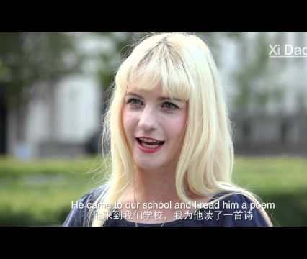
Propaganda example
Who is Xi Dada?

Slide 3
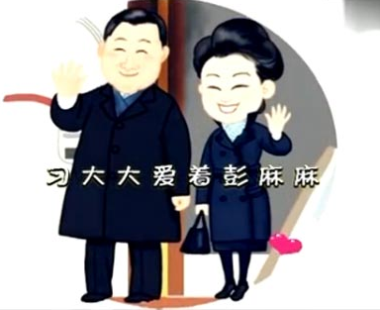
If one dose of propaganda is not enough…
Xi Dada loves Peng Mama

Slide 4
Propaganda institutions
Propaganda Department of the Chinese Communist Party
Cyberspace Administration
National Radio and Television Administration
Film Administration
People’s Daily
Xinhua News Agency
CCTV

Slide 5
Propaganda institutions
“Virtually every conceivable medium which transmits and conveys information to the people of China falls under the bureaucratic purview of the CCP Propaganda Department.” –David Shambaugh (2007)
Equivalent to a ministry directly controlling all media outlets from the Guardian, to BBC, to Daily Mail, as well as monitoring and supervising all social media platforms including Facebook, Twitter, Instagram, etc.

Slide 6
How does it work in practice?
“Reports on the situation in Ukraine that are unfavorable to Russia and pro-Western should not appear…When there are hot topics about the war, only use articles published by the People’s Daily, Xinhua News Agency, and CCTV.”
Propaganda directive, February 2, 2022
“Regarding the death of Dr. Li Wenliang of Wuhan Central Hospital, strictly regulate the source of manuscripts, and strictly prohibit using unauthorized reporting. No notifications, no comments, and no trending. The popularity of discussion should be carefully controlled; do not create trending topics, gradually remove trending searches, and harmful information should be strictly controlled.”
Propaganda directive, February 6, 2020
Examples of propaganda directives

Slide 7
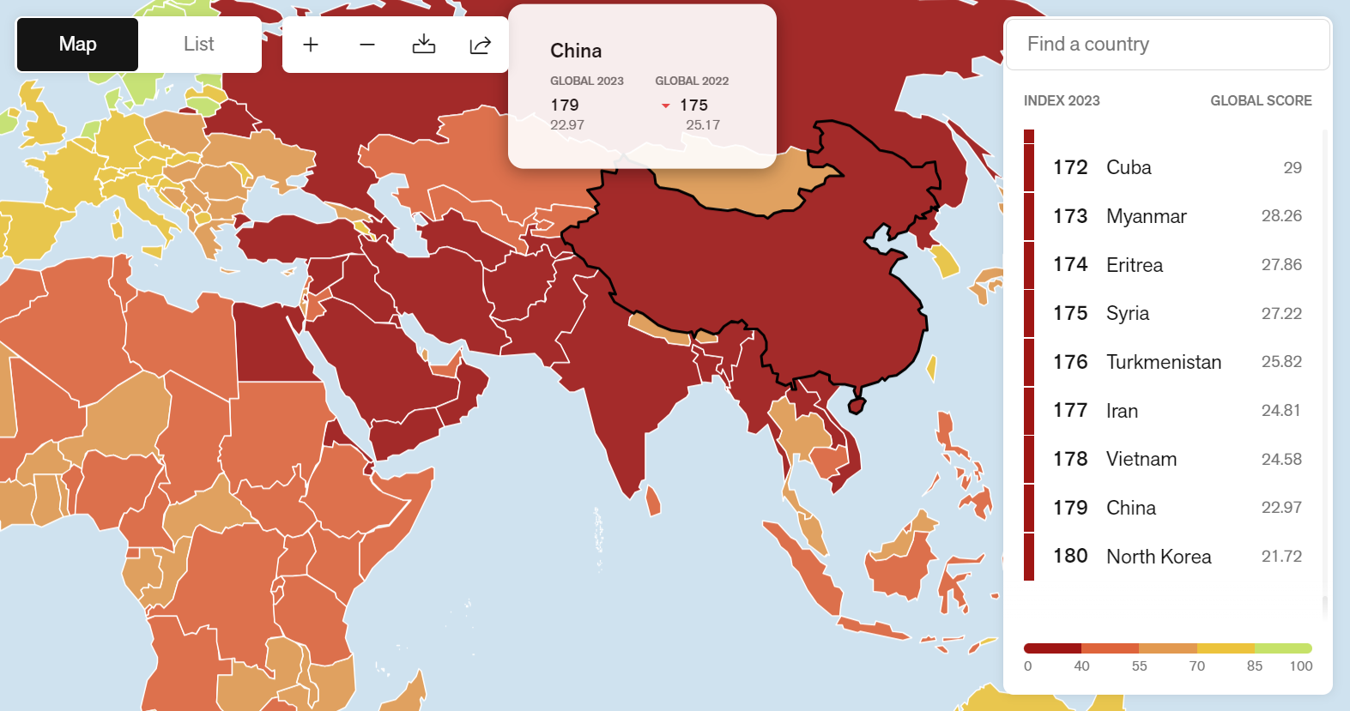

Slide 8
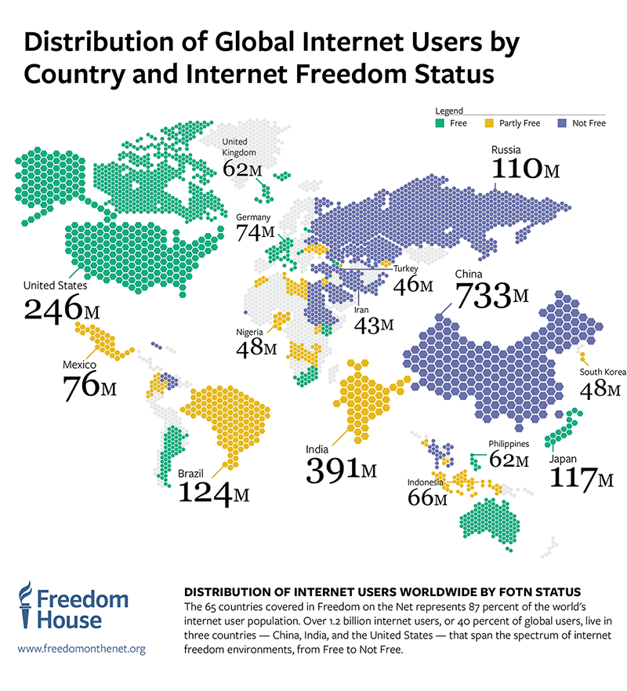
Censorship

Slide 9
History of the internet in China
1994: internet arrives in China
1998: ”Golden Shield” project begins
2006: completion of “Golden Shield”
2009: Facebook and Twitter blocked
2009-2010: internet blackouts in Xinjiang, Tibet
2010: China blocked Google. Google China moved servers to HK
2013: New York Times blocked
2016: VPN crackdowns begin

Slide 10

THE GREAT FIREWALL
Developed between 1998-2006
Blocks sensitive comments and websites
Channels internet users to domestically run, state-monitored sites
Creates a Chinese domestic internet with parallel search engines, webpages etc.

Slide 11
Facebook (and Messenger)
Instagram
Pinterest
Twitter
Blogger
Tumblr
Blogspot
New York Times
The Financial Times
The Economist
The Wall Street Journal
Bloomberg
Google News
Wikipedia
YouTube
Netflix
Vimeo
Google Search
Bing
Yahoo
DuckDuckGo
Messenger (and Facebook)
WeChat
Snapchat
Telegram
Signal
Test if a site is blocked in China

Slide 12
Intranet

Slide 13

Search engine examples

Slide 14
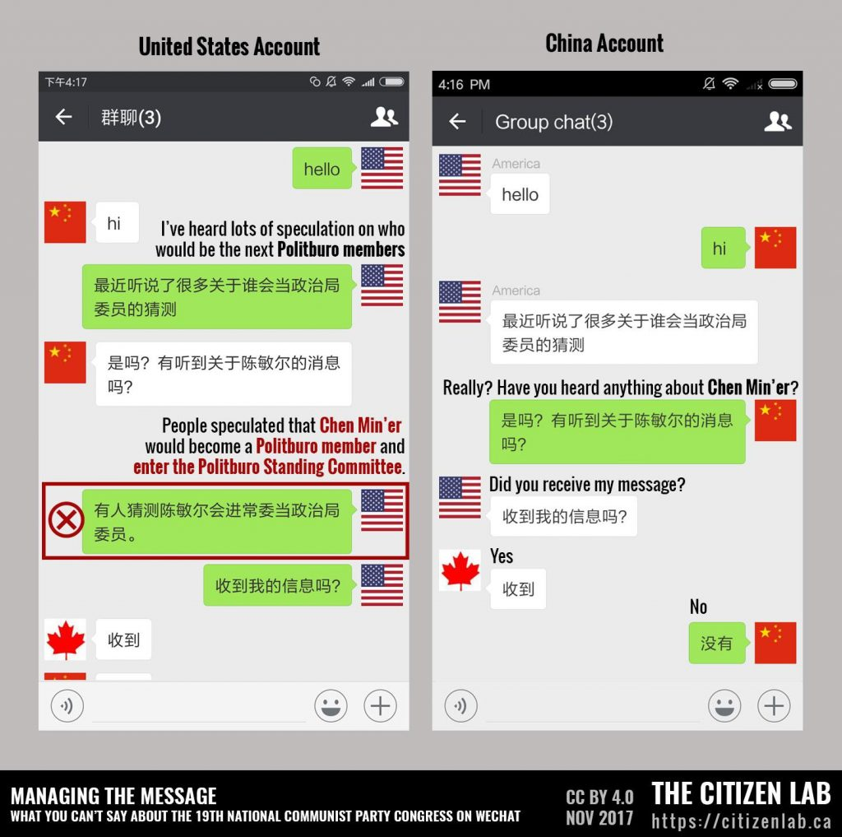
Illustration of one-to-one user chat censorship in WeChat by CitizenLab at the University of Toronto

Slide 15
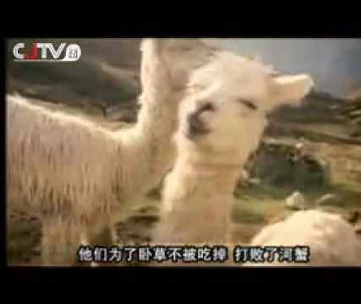
And then there is resistance.
Song of the "Grass Mud Horse"

Slide 16
Does propaganda work? If yes, how?
Propaganda that mobilizes people
Propaganda that coerces people
Propaganda that signals to foreign audiences
Propaganda that diverts attention
Propaganda that pacifies nationalists

Slide 17

Propaganda that mobilizes the domestic population
Can propaganda content arouse anti-foreign attitudes?

Slide 18
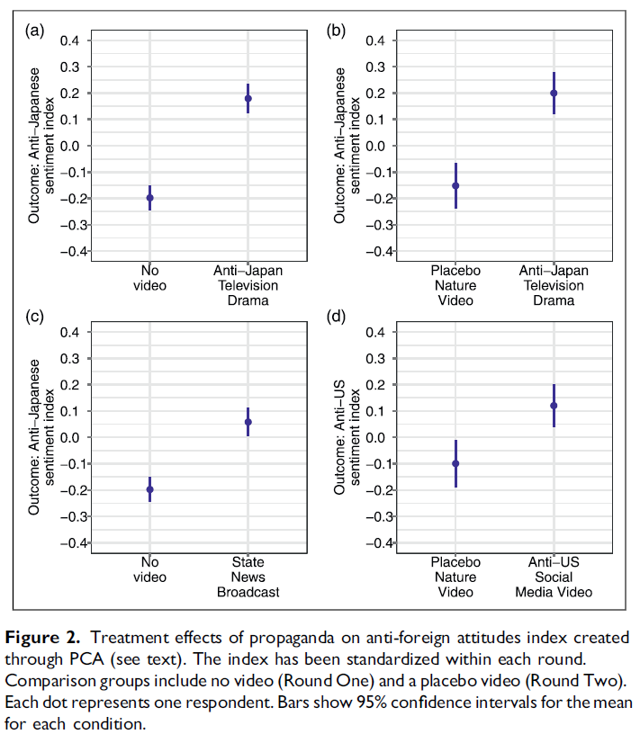
Can propaganda content arouse anti-foreign attitudes?
Mattingly and Yao 2022
Headline findings: Propaganda effectively manipulates anger as well as anti-foreign sentiment and behavior, with heightened anti-foreign attitudes persisting up to a week.

Slide 19
Anti-Japan television drama = a television drama about the Sino-Japanese War;
State news broadcast = newscast focusing on Xi Jinping’s participation in the annual national commemoration of the 1937 Nanjing Massacre, one of three public holidays memorializing the war;
Anti-US social media video = a video containing a message denouncing American interference in the 2019 Hong Kong protests.

Slide 20
The television drama soft propaganda clip had the largest effect, increasing anti-Japanese sentiment by 0.38 of a SD in the Round One survey and a nearly identical 0.35 of a SD in the Round Two survey, where the comparison group viewed a placebo video instead of no video.
The television news propaganda clip covering Nanjing war memorials increased anti-foreign attitudes in our index by 0.26 of a SD.
The social media clips about US interference in Hong Kong increased anti-foreign attitudes by 0.22 of a SD.

Slide 21
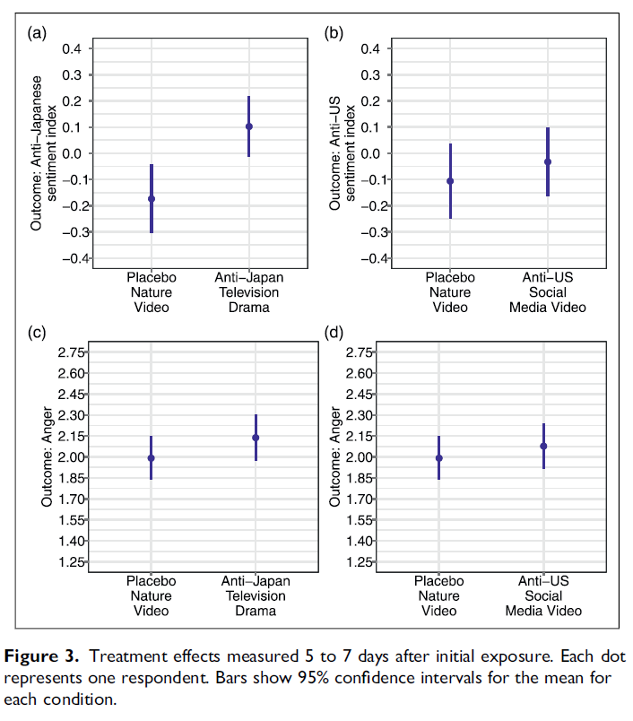
Do the effects of soft propaganda endure?
Soft propaganda’s persuasive effects can endure for as long as a week.
The effect of the anti-Japan drama remains statistically significant after five to 7 days, and the size of the effect has declined slightly from 0.35 to 0.22 of a SD.14
The estimated effect size of the anti-US social media clip declined at a slightly faster rate, from 0.22 to 0.10, and is no longer statistically significant.

Slide 22
Propaganda that mobilizes
Suthan Krishnarajan, Jakob Tolstrup, Pre-war experimental evidence that Putin’s propaganda elicited strong support for military invasion among Russians. Sci. Adv.9,eadg1199(2023).
In February 2022, Russia invaded Ukraine. The Putin regime used extensive and aggressive propaganda to win public support for the war.
But can this propaganda really convince ordinary people? Using the unique timing of a survey experiment fielded a year before the invasion, they provide the first experimental evidence of the effectiveness of this propaganda among Russian citizens.
A COMPARATIVE PERSPECTIVE

Slide 23
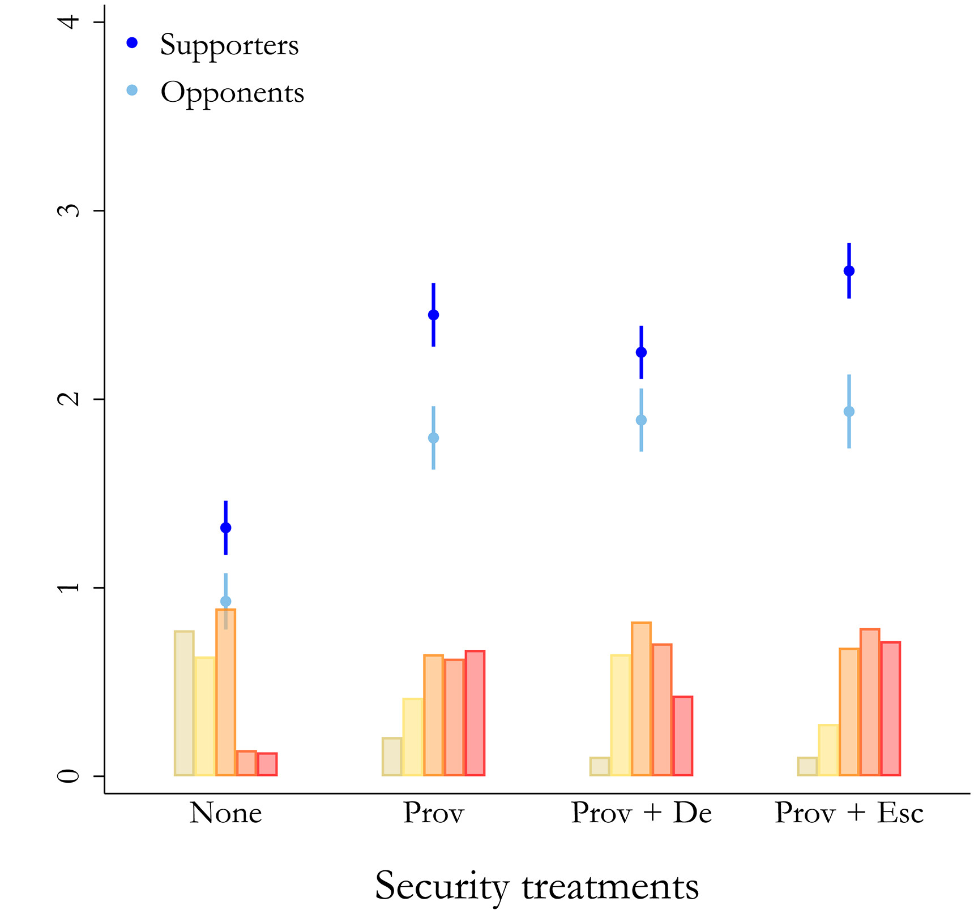
Vignette treatments containing information on threats similar to stories running in Russian media around the time of the invasion in combination with statements from President Putin show that propaganda was highly effective.
Even mild treatments were enough to increase support for military aggression against neighboring countries among Russians from around 8 to 48% and up to 59% among Putin’s supporters. Thus, the Russian president had good reason to believe that he could control popular opinion when he decided to launch a war against Ukraine.

Slide 24
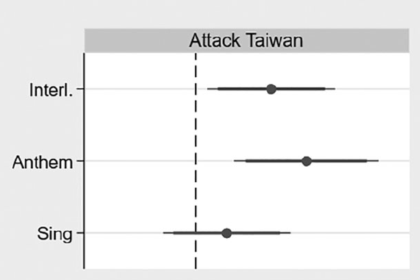
Is Taiwan the next Ukraine?
Liu and Shao 2023:
Headline findings: Nationalist propaganda increases people’s support for taking Taiwan by the military force.

Slide 25
Is Taiwan the next Ukraine?
Propaganda songs, on average, increased support for the war with Taiwan by 3.3% (Ttest results: 4.1% and 0.13 standard deviation).
Figure 1: Treatment effects of propaganda music [Interl. = the Internationale; (2) Anthem = the National Anthem of China; and (3) Sing = Ode to the Motherland (aka Sing for the Motherland)]

Slide 26
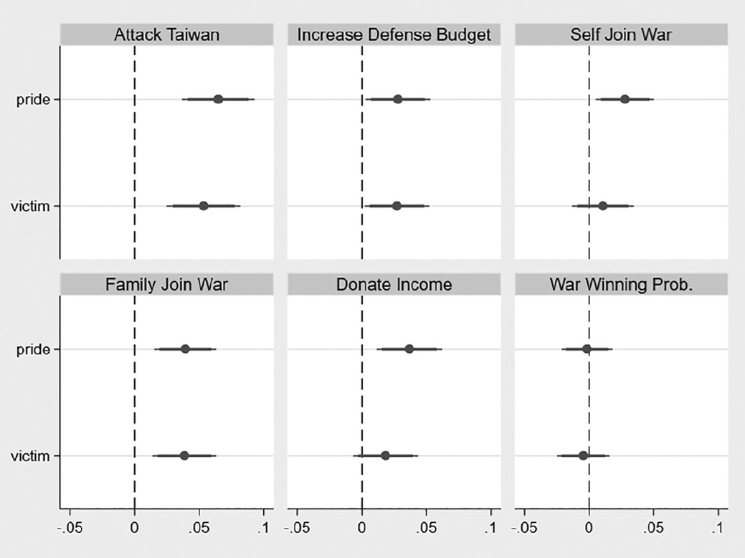
Is Taiwan the next Ukraine?
Both types of nationalist propaganda can increase support for the Taiwan war.
People exposed to treatment groups are also more supportive of defense budget increases, more likely to join the military themselves, more likely to support their family members in joining the military, and willing to donate more income to the war.
Figure 2: Treatment effects of the pride and victim narratives about Taiwan. Pride = Taiwan issue is connected to ‘China’s Dream’ and the ‘Rejuvenation of the Chinese Nation’. Victim = the Taiwan issue has been a lingering source of humiliation in modern Chinese history.

Slide 27
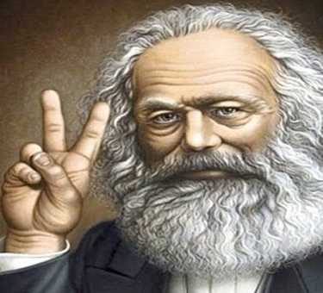
Propaganda that coerces
HIP-HOP SONG OF KARL MARX

Slide 28
Propaganda that coerces
Propaganda often is not used for indoctrination of pro-regime values and attitudes, as is traditionally understood, but rather to signal the government's strength in maintaining social control and political order.
Chinese college students with more exposure to state propaganda in the form of ideological and political education are not more satisfied with China's government system, but are more likely to believe that the regime is strong in maintaining social control and less willing to participate in political dissent.
Huang, Haifeng. "Propaganda as signaling." Comparative Politics 47.4 (2015): 419-444.

Slide 29
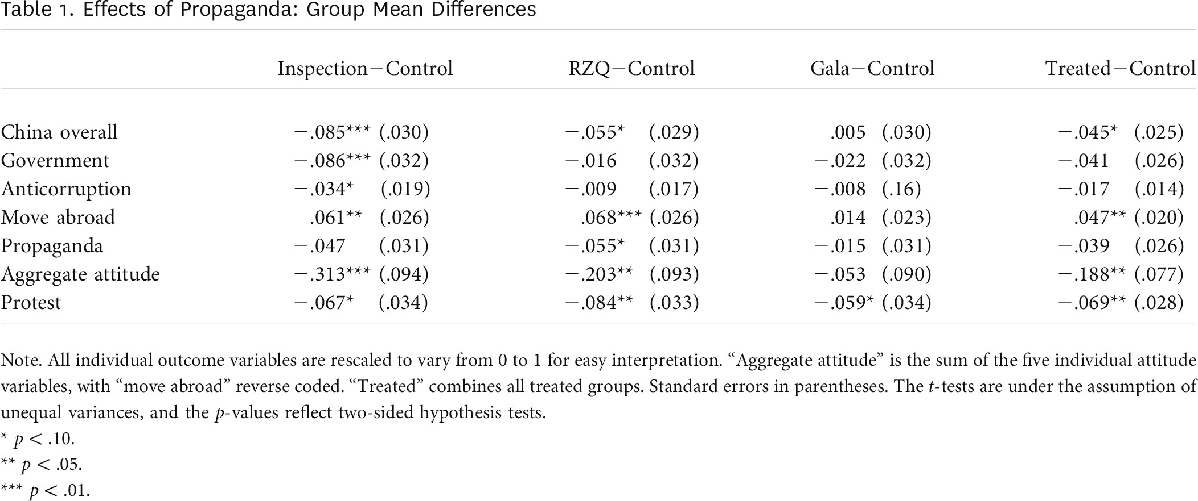
HUANG 2018
With an original survey experiment featuring messages from China’s ongoing propaganda campaign, this study finds that hard propaganda can backfire and worsen citizens’ opinions of the regime, while at the same time signaling the state’s power and reducing citizens’ willingness to protest.

Slide 30

Propaganda that signals to foreign audiences
CHILDREN FROM BELT AND ROAD COUNTRIES SING OUT THEIR GRATITUDE

Slide 31

Thank You!
Your questions and comments are welcome!

Slide 32

Appendix

Slide 33
Propaganda that pacifies nationalists
ANECDOTE: NANCY PELOSI AND SU-35

Slide 34
Propaganda that diverts attention
ANECDOTE: URUMUQI FIRE AND 吴亦凡

Slide 35

CHINESE TWO SESSION RAP

